Slide 1

Chapter 5: Mining Frequent Patterns, Association and Correlations
Basic concepts and a road map
Efficient and scalable frequent itemset mining methods
Mining various kinds of association rules
From association mining to correlation analysis
Constraint-based association mining
Summary
二〇二六年十一月八日
Data Mining: Concepts and Techniques

Slide 2
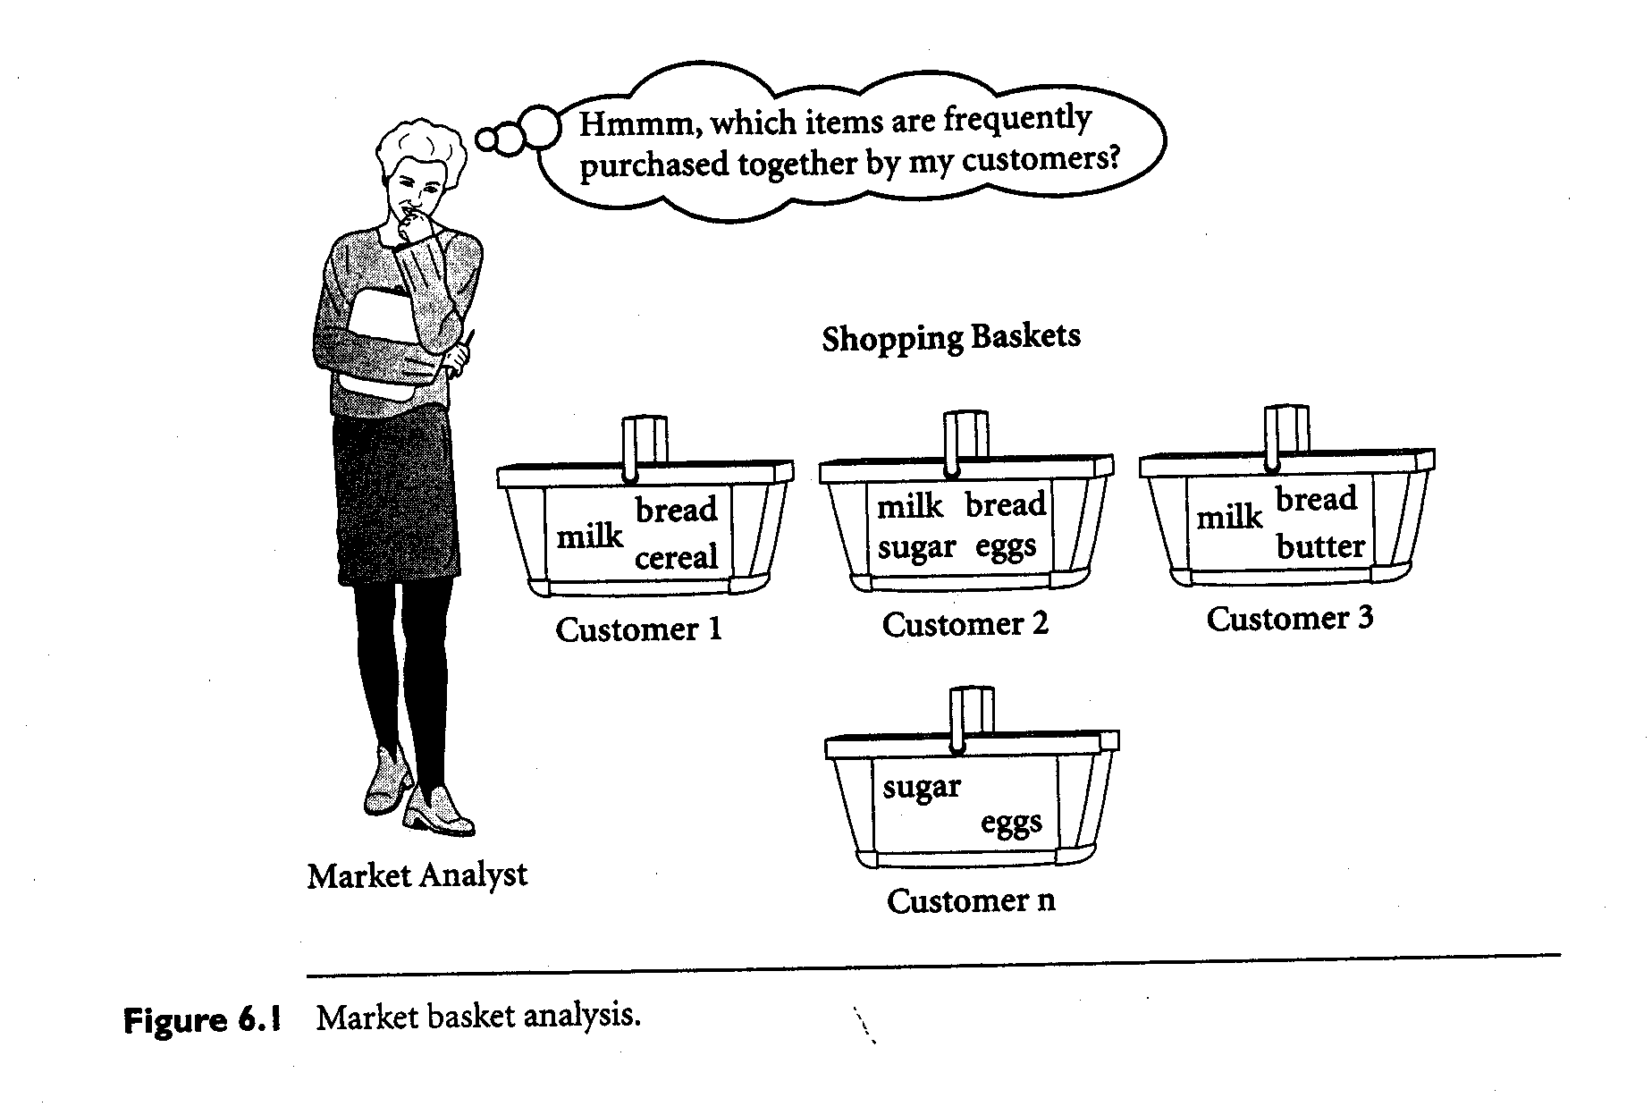
二〇二六年十一月八日
Data Mining: Concepts and Techniques

Slide 3
What Is Frequent Pattern Analysis?
Frequent pattern: a pattern (a set of items, subsequences, substructures, etc.) that occurs frequently in a data set
First proposed by Agrawal, Imielinski, and Swami [AIS93] in the context of frequent itemsets and association rule mining
Motivation: Finding inherent regularities in data
  What products were often purchased together?— Beer and diapers?!
  What are the subsequent purchases after buying a PC?
  What kinds of DNA are sensitive to this new drug?
  Can we automatically classify web documents?
Applications
  Basket data analysis, cross-marketing, catalog design, sale campaign analysis, Web log (click stream) analysis, and DNA sequence analysis.
二〇二六年十一月八日
Data Mining: Concepts and Techniques
Notes:
You have to definte the pattern and the frequently

Slide 4
Why Is Freq. Pattern Mining Important?
Discloses an intrinsic and important property of data sets
Forms the foundation for many essential data mining tasks
  Association, correlation, and causality analysis
  Sequential, structural (e.g., sub-graph) patterns
  Pattern analysis in spatiotemporal, multimedia, time-series, and stream data
  Classification: associative classification
  Cluster analysis: frequent pattern-based clustering
  Data warehousing: iceberg cube and cube-gradient
  Semantic data compression: fascicles
  Broad applications
二〇二六年十一月八日
Data Mining: Concepts and Techniques

Slide 5
Basic Concepts: Frequent Patterns and Association Rules
Transaction-id | Items bought
10 | A, B, D
20 | A, C, D
30 | A, D, E
40 | B, E, F
50 | B, C, D, E, F
Itemset X = {x₁, …, x_{k}}
Find all the rules X → Y with minimum support and confidence
  support, s, probability that a transaction contains X ∪ Y
  confidence, c, conditional probability that a transaction having X also contains Y
Customer
buys both
Customer
buys diaper
Let sup_{min} = 50%, conf_{min} = 50%
Freq. Pat.: {A:3, B:3, D:4, E:3, AD:3}
Association rules:
  A → D (60%, 100%)
  D → A (60%, 75%)
Customer
buys beer
二〇二六年十一月八日
Data Mining: Concepts and Techniques

Slide 6
Given a minimum support s and a minimum confidence c, find all the rules that satisfy:
The support of the rules are greater than s
The confidence of the rules are greater than c
Support : "How useful is the rule?"
Confidence: “How true is the rules ?“
二〇二六年十一月八日
Data Mining: Concepts and Techniques

Slide 7
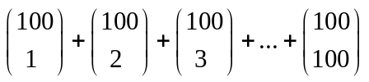
Closed Patterns and Max-Patterns
A long pattern contains a combinatorial number of sub-patterns, e.g., {a₁, …, a₁₀₀} contains = 2¹⁰⁰ – 1 = 1.27*10³⁰ sub-patterns!
Solution: Mine closed patterns and max-patterns instead
An itemset X is closed if X is frequent and there exists no super-pattern Y כ X, with the same support as X (proposed by Pasquier, et al. @ ICDT’99)
An itemset X is a max-pattern if X is frequent and there exists no frequent super-pattern Y כ X (proposed by Bayardo @ SIGMOD’98)
Closed pattern is a lossless compression of freq. patterns
  Reducing the # of patterns and rules
二〇二六年十一月八日
Data Mining: Concepts and Techniques

Slide 8

Frequent Itemset Generation
Given d items, there are 2^{d} possible candidate itemsets
二〇二六年十一月八日
Data Mining: Concepts and Techniques

Slide 9
Closed Patterns and Max-Patterns
Exercise. DB = {<a₁, …, a₁₀₀>, < a₁, …, a₅₀>}
  Min_sup = 0.5
What is the set of closed itemset?
  <a₁, …, a₁₀₀>: 1
  < a₁, …, a₅₀>: 2
What is the set of max-pattern?
  <a₁, …, a₁₀₀>: 1
What is the set of all patterns?
  !!
二〇二六年十一月八日
Data Mining: Concepts and Techniques

Slide 10
Chapter 5: Mining Frequent Patterns, Association and Correlations
Basic concepts and a road map
Efficient and scalable frequent itemset mining methods
Mining various kinds of association rules
From association mining to correlation analysis
Constraint-based association mining
Summary
二〇二六年十一月八日
Data Mining: Concepts and Techniques

Slide 11
Scalable Methods for Mining Frequent Patterns
The downward closure property of frequent patterns
  Any subset of a frequent itemset must be frequent
  If {beer, diaper, nuts} is frequent, so is {beer, diaper}
  i.e., every transaction having {beer, diaper, nuts} also contains {beer, diaper}
Scalable mining methods: Three major approaches
  Apriori (Agrawal & Srikant@VLDB’94)
  Freq. pattern growth (FPgrowth—Han, Pei & Yin @SIGMOD’00)
  Vertical data format approach (Charm—Zaki & Hsiao @SDM’02)
二〇二六年十一月八日
Data Mining: Concepts and Techniques

Slide 12
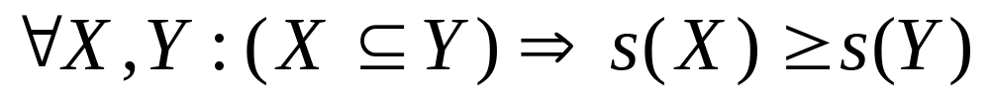
Reducing Number of Candidates
Apriori principle:
  If an itemset is frequent, then all of its subsets must also be frequent
Apriori principle holds due to the following property of the support measure:
  Support of an itemset never exceeds the support of its subsets
  This is known as the anti-monotone property of support
二〇二六年十一月八日
Data Mining: Concepts and Techniques
Notes:
項目越常支持的交易會越短??

Slide 13
Apriori: A Candidate Generation-and-Test Approach
Apriori pruning principle: If there is any itemset which is infrequent, its superset should not be generated/tested! (Agrawal & Srikant @VLDB’94, Mannila, et al. @ KDD’ 94)
Method:
  Initially, scan DB once to get frequent 1-itemset
  Generate length (k+1) candidate itemsets from length k frequent itemsets
  Test the candidates against DB
  Terminate when no frequent or candidate set can be generated
二〇二六年十一月八日
Data Mining: Concepts and Techniques

Slide 14


Illustrating Apriori Principle
Found to be Infrequent
Pruned supersets
二〇二六年十一月八日
Data Mining: Concepts and Techniques

Slide 15
The Apriori Algorithm—An Example
Minimum Support count =2
Sup_{min} = 0.5
Itemset | sup
{A} | 2
{B} | 3
{C} | 3
{D} | 1
{E} | 3
Database TDB
Itemset | sup
{A} | 2
{B} | 3
{C} | 3
{E} | 3
L₁
Tid | Items
10 | A, C, D
20 | B, C, E
30 | A, B, C, E
40 | B, E
C₁
1st scan
C₂
Itemset | sup
{A, B} | 1
{A, C} | 2
{A, E} | 1
{B, C} | 2
{B, E} | 3
{C, E} | 2
C₂
L₂
Itemset
{A, B}
{A, C}
{A, E}
{B, C}
{B, E}
{C, E}
Itemset | sup
{A, C} | 2
{B, C} | 2
{B, E} | 3
{C, E} | 2
2nd scan
C₃
Itemset
{B, C, E}
3rd scan
L₃
Itemset | sup
{B, C, E} | 2
二〇二六年十一月八日
Data Mining: Concepts and Techniques

Slide 16
The Apriori Algorithm
Pseudo-code:
    C_{k}: Candidate itemset of size k
    L_{k} : frequent itemset of size k
    L₁ = {frequent items};
    for (k = 1; L_{k} !=∅; k++) do begin
    C_{k+1} = candidates generated from L_{k};
    for each transaction t in database do
      increment the count of all candidates in C_{k+1} that are contained in t
    L_{k+1} = candidates in C_{k+1} with min_support
    end
    return ∪_{k} L_{k};
二〇二六年十一月八日
Data Mining: Concepts and Techniques

Slide 17
Important Details of Apriori
How to generate candidates?
  Step 1: self-joining L_{k}
  Step 2: pruning
How to count supports of candidates?
Example of Candidate-generation
  L₃={abc, abd, acd, ace, bcd}
  Self-joining: L₃*L₃
    abcd from abc and abd
    acde from acd and ace
  Pruning:
    acde is removed because ade is not in L₃
  C₄={abcd}
二〇二六年十一月八日
Data Mining: Concepts and Techniques

Slide 18
How to Generate Candidates?
Suppose the items in L_{k-1} are listed in order
Step 1: self-joining L_{k-1}
  insert into C_{k}
  select p.item₁, p.item₂, …, p.item_{k-1}, q.item_{k-1}
  from L_{k-1} p, L_{k-1} q
  where p.item₁=q.item₁, …, p.item_{k-2}=q.item_{k-2}, p.item_{k-1} < q.item_{k-1}
Step 2: pruning
  forall itemsets c in C_{k} do
    forall (k-1)-subsets s of c do
      if (s is not in L_{k-1}) then delete c from C_{k}
二〇二六年十一月八日
Data Mining: Concepts and Techniques

Slide 19
Efficient Implementation of Apriori in SQL
Hard to get good performance out of pure SQL (SQL-92) based approaches alone
Make use of object-relational extensions like UDFs, BLOBs, Table functions etc.
  Get orders of magnitude improvement
S. Sarawagi, S. Thomas, and R. Agrawal. Integrating association rule mining with relational database systems: Alternatives and implications. In SIGMOD’98
二〇二六年十一月八日
Data Mining: Concepts and Techniques

Slide 20
Challenges of Frequent Pattern Mining
Challenges
  Multiple scans of transaction database
  Huge number of candidates
  Tedious workload of support counting for candidates
Improving Apriori: general ideas
  Reduce passes of transaction database scans
  Shrink number of candidates
  Facilitate support counting of candidates
二〇二六年十一月八日
Data Mining: Concepts and Techniques

Slide 21
Construct FP-tree from a Transaction Database
TID Items bought (ordered) frequent items
100 {f, a, c, d, g, i, m, p} {f, c, a, m, p}
200 {a, b, c, f, l, m, o} {f, c, a, b, m}
300 {b, f, h, j, o, w} {f, b}
400 {b, c, k, s, p} {c, b, p}
500 {a, f, c, e, l, p, m, n} {f, c, a, m, p}
min_support = 3
{}
Header Table
Item frequency head
f 4
c 4
a 3
b 3
m 3
p 3
Scan DB once, find frequent 1-itemset (single item pattern)
Sort frequent items in frequency descending order, f-list
Scan DB again, construct FP-tree
f:4
c:1
c:3
b:1
b:1
a:3
p:1
m:2
b:1
F-list=f-c-a-b-m-p
p:2
m:1
二〇二六年十一月八日
Data Mining: Concepts and Techniques

Slide 22
Benefits of the FP-tree Structure
Completeness
  Preserve complete information for frequent pattern mining
  Never break a long pattern of any transaction
Compactness
  Reduce irrelevant info—infrequent items are gone
  Items in frequency descending order: the more frequently occurring, the more likely to be shared
  Never be larger than the original database (not count node-links and the count field)
  For Connect-4 DB, compression ratio could be over 100
二〇二六年十一月八日
Data Mining: Concepts and Techniques

Slide 23
Partition Patterns and Databases
Frequent patterns can be partitioned into subsets according to f-list
  F-list=f-c-a-b-m-p
  Patterns containing p
  Patterns having m but no p
  …
  Patterns having c but no a nor b, m, p
  Pattern f
Completeness and non-redundency
二〇二六年十一月八日
Data Mining: Concepts and Techniques

Slide 24
Find Patterns Having P From P-conditional Database
Starting at the frequent item header table in the FP-tree
Traverse the FP-tree by following the link of each frequent item p
Accumulate all of transformed prefix paths of item p to form p’s conditional pattern base
{}
Header Table
Item frequency head
f 4
c 4
a 3
b 3
m 3
p 3
f:4
c:1
Conditional pattern bases
item cond. pattern base
c f:3
a fc:3
b fca:1, f:1, c:1
m fca:2, fcab:1
p fcam:2, cb:1
c:3
b:1
b:1
a:3
p:1
m:2
b:1
p:2
m:1
二〇二六年十一月八日
Data Mining: Concepts and Techniques

Slide 25
From Conditional Pattern-bases to Conditional FP-trees
For each pattern-base
  Accumulate the count for each item in the base
  Construct the FP-tree for the frequent items of the pattern base
m-conditional pattern base:
  fca:2, fcab:1
{}
Header Table
Item frequency head
f 4
c 4
a 3
b 3
m 3
p 3
f:4
c:1
All frequent patterns relate to m
m,
fm, cm, am,
fcm, fam, cam,
fcam
{}
c:3
b:1
b:1

f:3

a:3
p:1
m:2
b:1
c:3
p:2
m:1
a:3
m-conditional FP-tree
二〇二六年十一月八日
Data Mining: Concepts and Techniques

Slide 26
Recursion: Mining Each Conditional FP-tree
{}
{}
Cond. pattern base of “am”: (fc:3)
f:3
c:3
f:3
am-conditional FP-tree
c:3
{}
Cond. pattern base of “cm”: (f:3)
a:3
f:3
m-conditional FP-tree
cm-conditional FP-tree
fm
{}
Cond. pattern base of “cam”: ()
cam-conditional FP-tree
二〇二六年十一月八日
Data Mining: Concepts and Techniques

Slide 27
A Special Case: Single Prefix Path in FP-tree
Suppose a (conditional) FP-tree T has a shared single prefix-path P
Mining can be decomposed into two parts
  Reduction of the single prefix path into one node
  Concatenation of the mining results of the two parts
{}
a₁:n₁
a₂:n₂
a₃:n₃
{}
r₁
b₁:m₁
C₁:k₁
a₁:n₁
+

r₁
=
b₁:m₁
C₁:k₁
a₂:n₂
C₂:k₂
C₃:k₃
a₃:n₃
C₂:k₂
C₃:k₃
二〇二六年十一月八日
Data Mining: Concepts and Techniques

Slide 28
Mining Frequent Patterns With FP-trees
Idea: Frequent pattern growth
  Recursively grow frequent patterns by pattern and database partition
Method
  For each frequent item, construct its conditional pattern-base, and then its conditional FP-tree
  Repeat the process on each newly created conditional FP-tree
  Until the resulting FP-tree is empty, or it contains only one path—single path will generate all the combinations of its sub-paths, each of which is a frequent pattern
二〇二六年十一月八日
Data Mining: Concepts and Techniques

Slide 29
Why Is FP-Growth the Winner?
Divide-and-conquer:
  decompose both the mining task and DB according to the frequent patterns obtained so far
  leads to focused search of smaller databases
Other factors
  no candidate generation, no candidate test
  compressed database: FP-tree structure
  no repeated scan of entire database
  basic ops—counting local freq items and building sub FP-tree, no pattern search and matching
二〇二六年十一月八日
Data Mining: Concepts and Techniques

Slide 30

Visualization of Association Rules: Plane Graph
二〇二六年十一月八日
Data Mining: Concepts and Techniques

Slide 31

Visualization of Association Rules
(SGI/MineSet 3.0)
二〇二六年十一月八日
Data Mining: Concepts and Techniques

Slide 32
Chapter 5: Mining Frequent Patterns, Association and Correlations
Basic concepts and a road map
Efficient and scalable frequent itemset mining methods
Mining various kinds of association rules
From association mining to correlation analysis
Constraint-based association mining
Summary
二〇二六年十一月八日
Data Mining: Concepts and Techniques

Slide 33
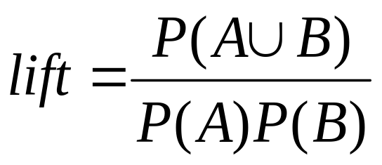
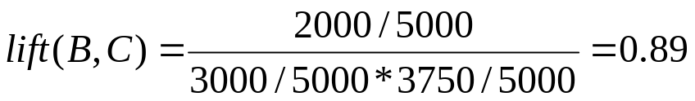
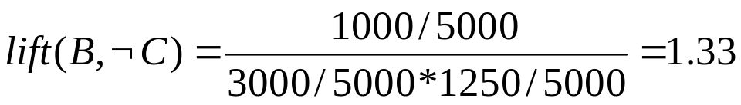
Interestingness Measure: Correlations (Lift)
play basketball ⇒ eat cereal [40%, 66.7%] is misleading
  The overall % of students eating cereal is 75% > 66.7%.
play basketball ⇒ not eat cereal [20%, 33.3%] is more accurate, although with lower support and confidence
Measure of dependent/correlated events: lift
 | Basketball | Not basketball | Sum (row)
Cereal | 2000 | 1750 | 3750
Not cereal | 1000 | 250 | 1250
Sum(col.) | 3000 | 2000 | 5000
二〇二六年十一月八日
Data Mining: Concepts and Techniques

Slide 34
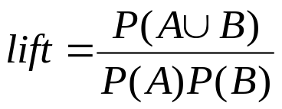
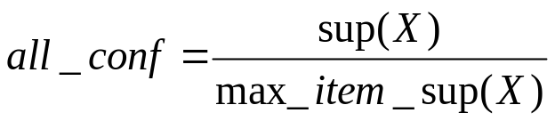
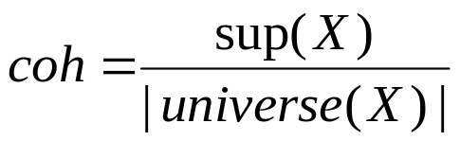
Are lift and χ² Good Measures of Correlation?
“Buy walnuts ⇒ buy milk [1%, 80%]” is misleading
  if 85% of customers buy milk
Support and confidence are not good to represent correlations
So many interestingness measures? (Tan, Kumar, Sritastava @KDD’02)
 | Milk | No Milk | Sum (row)
Coffee | m, c | ~m, c | c
No Coffee | m, ~c | ~m, ~c | ~c
Sum(col.) | m | ~m | Σ
DB | m, c | ~m, c | m~c | ~m~c | lift | all-conf | coh | χ2
A1 | 1000 | 100 | 100 | 10,000 | 9.26 | 0.91 | 0.83 | 9055
A2 | 100 | 1000 | 1000 | 100,000 | 8.44 | 0.09 | 0.05 | 670
A3 | 1000 | 100 | 10000 | 100,000 | 9.18 | 0.09 | 0.09 | 8172
A4 | 1000 | 1000 | 1000 | 1000 | 1 | 0.5 | 0.33 | 0
二〇二六年十一月八日
Data Mining: Concepts and Techniques

Slide 35

Which Measures Should Be Used?
lift and χ² are not good measures for correlations in large transactional DBs
all-conf or coherence could be good measures (Omiecinski@TKDE’03)
Both all-conf and coherence have the downward closure property
Efficient algorithms can be derived for mining (Lee et al. @ICDM’03sub)
二〇二六年十一月八日
Data Mining: Concepts and Techniques

Slide 36
Chapter 5: Mining Frequent Patterns, Association and Correlations
Basic concepts and a road map
Efficient and scalable frequent itemset mining methods
Mining various kinds of association rules
From association mining to correlation analysis
Constraint-based association mining
Summary
二〇二六年十一月八日
Data Mining: Concepts and Techniques

Slide 37
Frequent-Pattern Mining: Summary
Frequent pattern mining—an important task in data mining
Scalable frequent pattern mining methods
  Apriori (Candidate generation & test)
  Projection-based (FPgrowth, CLOSET+, ...)
  Vertical format approach (CHARM, ...)
Mining a variety of rules and interesting patterns
Constraint-based mining
Mining sequential and structured patterns
Extensions and applications
二〇二六年十一月八日
Data Mining: Concepts and Techniques

Slide 38
Frequent-Pattern Mining: Research Problems
Mining fault-tolerant frequent, sequential and structured patterns
  Patterns allows limited faults (insertion, deletion, mutation)
Mining truly interesting patterns
  Surprising, novel, concise, …
Application exploration
  E.g., DNA sequence analysis and bio-pattern classification
  “Invisible” data mining
二〇二六年十一月八日
Data Mining: Concepts and Techniques

